Slide 1

x
Axway EFSS Overview

Slide 2
The Way We Work Is Changing
Access
Share
Send
Protect
Notes:
The way we work is changing. In our personal life, we are used to be able to access or photos and videos and share with friends with just a few clicks. Today’s mobile workforce is demanding the same ability to access, share, and send business files any time, any where, and from any device. And users are now sophisticated enough to get what they want.

Slide 3
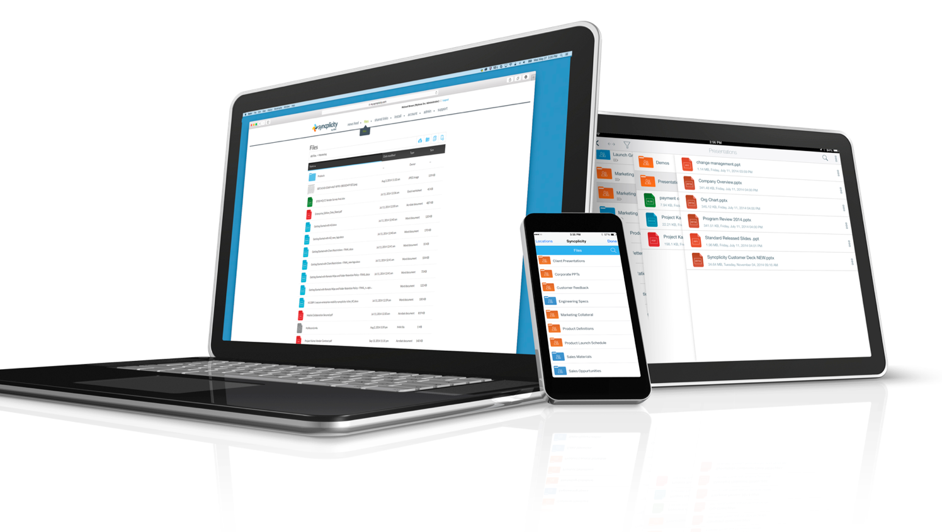


Slide 4

Accelerating Digital Transformation by Modernizing IT and Empowering the Digital Workplace
Digital Workplace
Modernization of IT
Data Governance
Secure File & Folder Sharing
Multi-Folder Sync = Real-Time Backup
Access to all Files, Anytime, Anywhere – No VPN required
Mobile Enterprise
Collaboration & Office 365 Integrations
Connect to Content Systems Across the Enterprise
File Share Replacement
On-Premises, Private or Public Cloud (US & EU)
Accelerate & Automate the Migration of Unstructured Content
Replace Legacy Storage & Reduce Costs
Maximum Visibility & Control
Zero Content Knowledge
Data Sovereignty Options to Address Global Privacy Concerns
Complete Protection for Private Information

Slide 5

Digital Transformation at Siemens
SIEMENS AG
One of the world’s largest and most admired companies leading in industry, energy, healthcare and infrastructure
SIEMENS IT GOALS
SMARTSTORAGE SOLUTION
CUT COST
Expensive NAS infrastructure ($60M / year)
REDUCE IT ADMINSTRATION
NAS file share infrastructure outdated
Distributed over 200+ data centers
INCREASE USER PRODUCTIVITY
No offline access
No mobile access
Limited to no sharing and collaboration
COST SAVINGS
Annual savings of $24 Million
Migration from NAS to Elastic Cloud Storage
REDUCED IT ADMINSTRATION
Modern Syncplicity EFSS solution
Consolidated down to 4 global data centers
INCREASED USER PRODUCTIVITY
Mobile and offline access from anywhere
Easy and secure internal and external sharing and collaboration
Real-time desktop document protection and backup

Slide 6
Syncplicity – Client

Slide 7


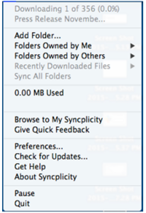
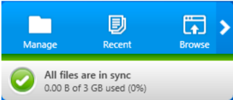
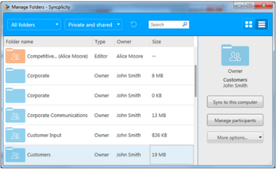
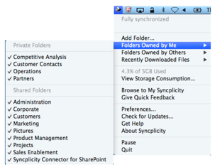
Desktop Client
Windows Systray icon
Mac Finder Icon
Mac Task Bar
Windows Task Bar
Windows Manage Folders View
Mac Manage
Folders View
Notes:
Native installers for Windows or Mac
User-Installed or pushed as a package
Requires local Admin permissions
Can have default folders mapped & sync’d by default
Desktop, Documents, Favorites, Music, Photos

Slide 8
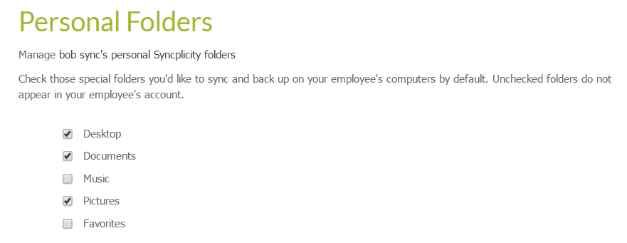
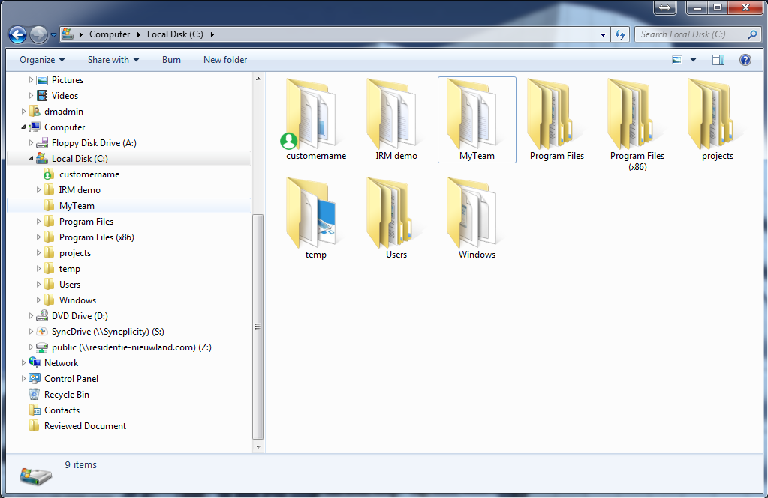
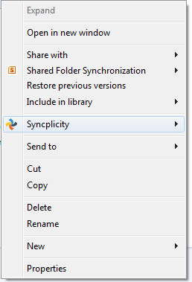
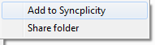
Local folder vs Syncplicity Folder
Multi/Any-folder sync (=no magical folder concept)
Right-Click, Add any folder.
Admin can enforce any folder to be synced. (= Free Desktop Protection)
Shared Folders (= Sync down folders that are shared to you)
Sub-Folder Sharing (=When different permissions are required on lower-level folders)

Slide 9
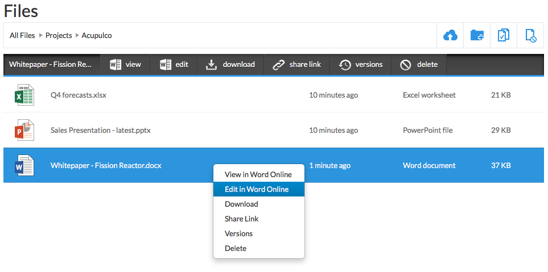
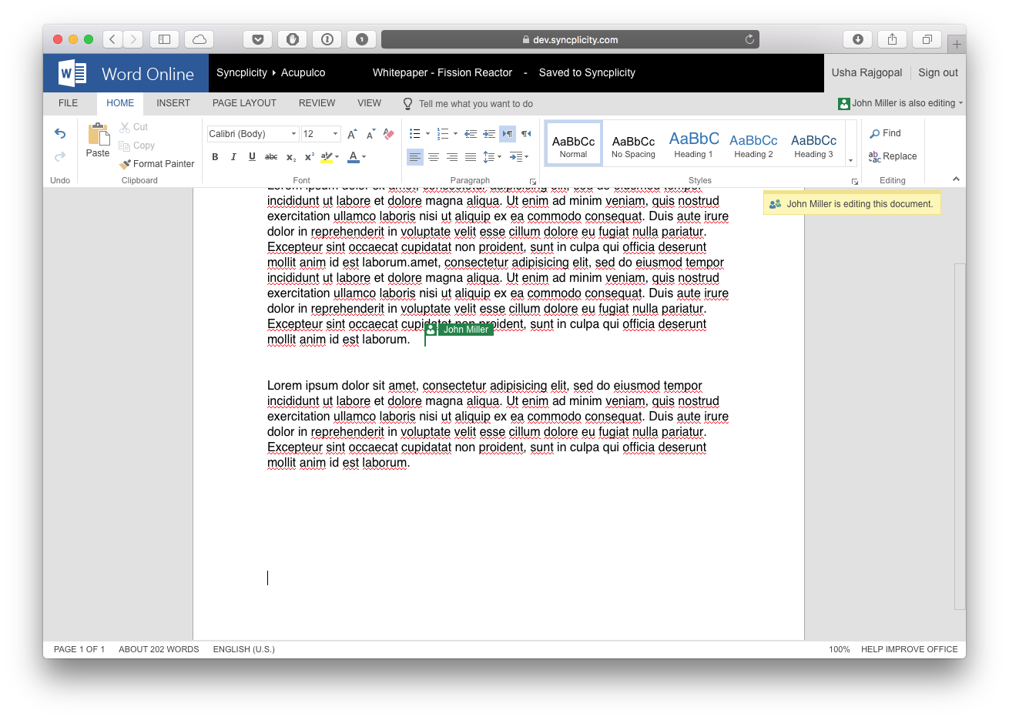
Office 365 Integration
Notes:
Online viewing and editing of Microsoft documents with Office 365 Online
Word, Excel, PowerPoint
Seamless integration into Syncplicity Online File Browser
Automatic save back to Syncplicity
Co-authoring in Office Online

Slide 10
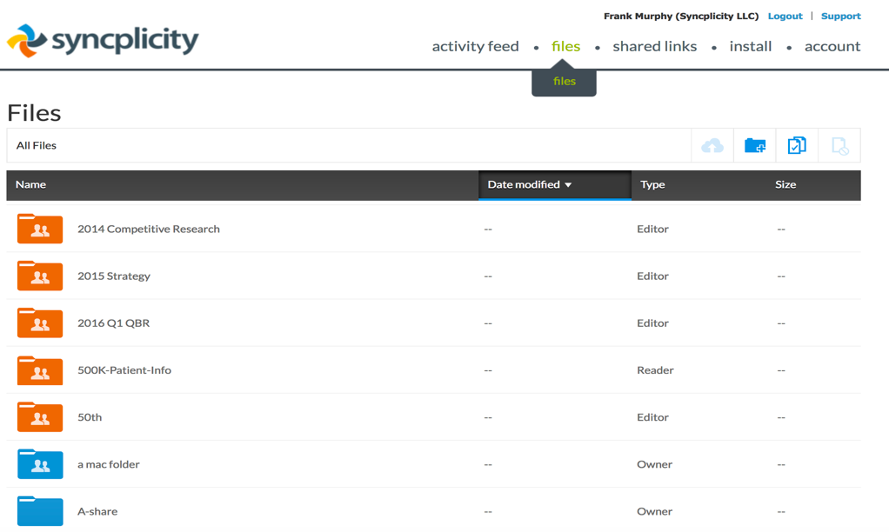
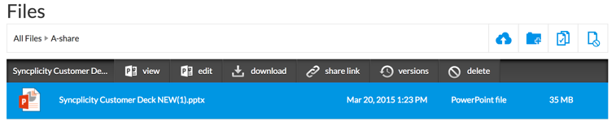
Online File Browser
https://my.syncplicity.com/files
Notes:
Online viewing and editing of Microsoft documents with Office 365 Online
Word, Excel, PowerPoint
Seamless integration into Syncplicity Online File Browser
Automatic save back to Syncplicity
Co-authoring in Office Online

Slide 11
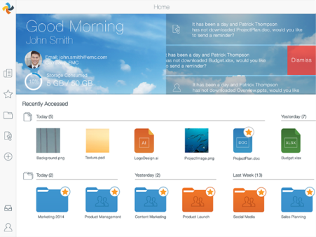
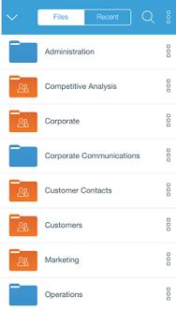
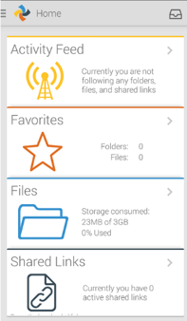
Mobile Client
iPad
iPhone
Android
Notes:
Designed to match device OS-specific UI standards not generic one-size-fits-all app
Deploys as a containerized app installed via app store, or pushed by MDM
Inherits MDM-like DLP Policies (open in restrictions, poison pill, PIN Locking, remote wipe)
Enhances MDM-specific policies (jailbreak/root detection, app sharing restrictions.
Both managed devices and BYOD devices (MDM override).
Access-based paradigm. Files are downloaded on demand & cached to device (or favorited for offline viewing) files are not automatically sync’d like the desktop client.

Slide 12
Syncplicity – Behind the Scenes

Slide 13
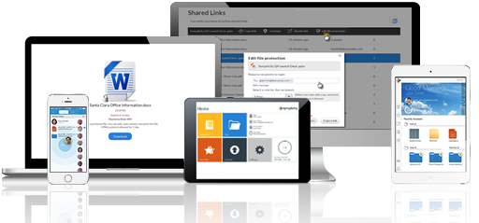











Syncplicity Security & Compliance
FRICTIONLESS USER EXPERIENCE
SECURITY
User | Device | Folder | File
Encryption, SSO, Remote Wipe, Retention, Reporting & Monitoring, Sharing/Access/Mobile Policies
ADMINISTRATION AND MANAGEMENT
User Management, Group Management, AD Sync
STORAGEVAULTS
Supported Storage Interfaces (NFS, S3, Atmos)
Syncplicity
Cloud
Service Provider
S3
NFS
OFF-PREMISE
ON-PREMISE
Notes:
Obviously, the goal of Syncplicity is to make it easy for users to access and share files from any device. We do this by providing a highly-secure cloud-based “orchestration” layer that acts as a conductor by enabling sharing between users and devices.
Syncplicity stores a copy of files and file history in our own data store so we can sync files across users and devices. Our customers can choose whether that data store resides in our cloud data center or on premise. Syncplicity works with any storage solution that supports NFS3 or S3 APIs, including EMC Isilon, EMC Atmos, EMC VNX, 3rd party storage such as Netapp, and EMC VIPR.
By choosing on premise storage, a customer gets several benefits:
They retain complete control over their data. In fact, in this configuration, their files are never cached or even pass through our service, they move directly from their storage to their devices.
They can manage data residency requirements.
And its easy to install and manage. Customers simply point Syncplicity to new or existing storage and Syncplicity will use that storage without any change to the user experience.
To give organizations maximum control, Syncplicity’s policy-driven hybrid cloud allows IT to set policies at the user, group, or folder level that determines where data is stored. Some content can be stored in the cloud, other content can be directed to data stores in specific geographies, and some content can be stored in other storage arrays based on need.

Slide 14
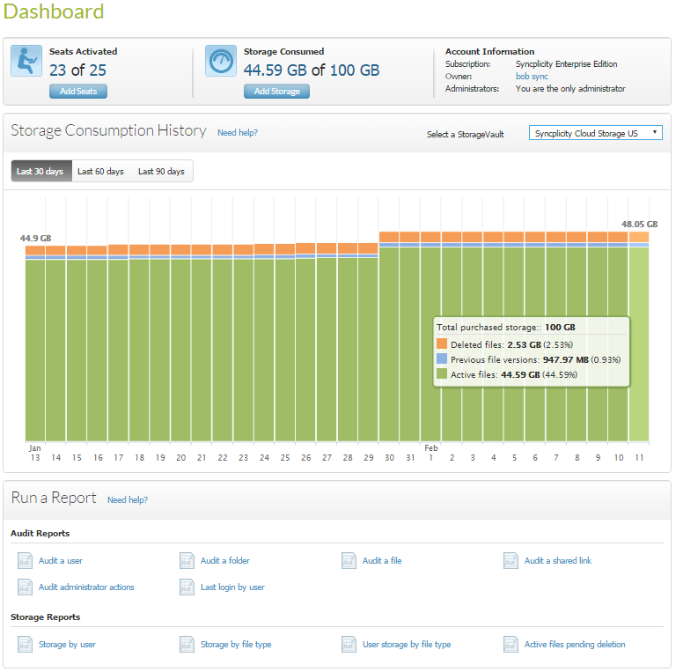
Syncplicity Administration
User
Protection
Device
Protection
Folder
Protection
File Protection
Monitoring and Reporting

Slide 15




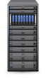

Architecture
INTERNET
CORPORATE NETWORK
Clients initiate requests to the Orchestration Layer to send file attributes as files are added to Client
Clients initiate requests to Orchestration Layer to ask if new files need to be downloaded
Syncplicity Clients
Syncplicity Clients
HSM
Clients initiate requests to upload/download files to Compute Node through a load balancer
SAML/AD Identity Provider
Load Balancer
Files are sent to Storage Connectors as part of the upload request(s) and stored in the Storage Layer
Files are retrieved from Storage Layer and downloaded to Clients from Compute Nodes as a response to file download requests
Storage Layer
NFS
NFS, S3, Atmos Interfaces
Compute Nodes
Storage Connectors store/retrieve file attributes and file location using Orchestration Layer
CLOUD-BASED PRIVACYREGIONS
(ORCHESTRATION)
S3
DMZ
PRIVATE
Notes:
In this animation, we see the three architecture components interacting during the file synchronization process.
First, in the green arrows, the client initiates requests to the Orchestration Layer to send file attributes as files are added to Client. To maintain synchronization, clients also initiate requests to the Orchestration Layer to ask if new files need to be downloaded
Next in the brown arrows, the clients initiate requests to upload/download files to the Compute Node through a load balancer. The files to be uploaded are sent to the Compute Node as part of the upload request(s) and are stored in the Storage Layer
Files to be downloaded are retrieved from Storage Layer and downloaded to Clients from the Compute Nodes as a response to file download requests
Finally, the Compute Nodes store/retrieve file attributes and file location using Orchestration Layer
Now let’s examine each of these components in detail

Slide 16

Demo

Slide 17




Demo Story Board – Client-Side & Sharing Use Cases
Use Case: folder sync of files in place: Editing files “over and back”
ANDROID
iOS
User
Syncs a local
folder &
MS Office Doc
Show files
sync’d in place
Access and edit
the same files “over” on
a 2nd device
Observe changes made
“back” on the desktop
Sharing Files & Folders
On desktop:
Create shared link,
Describe security policies
Share link with yourself
Show sender &
recipient experience
On Mobile:
Show same use cases:
Sharing folders & files

Slide 18


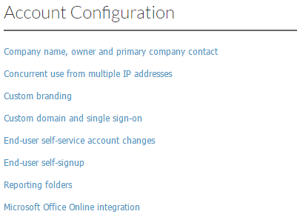
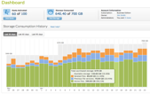
Demo Story Board – Admin Controls
Administration & Security
Group A
Group B
Group Based Policies:
Show 2 or 3
Group Based policies
Monitoring:
Show Dashboard
Reports
Describe Storage SSO & Compliance Settings

